Slide 1
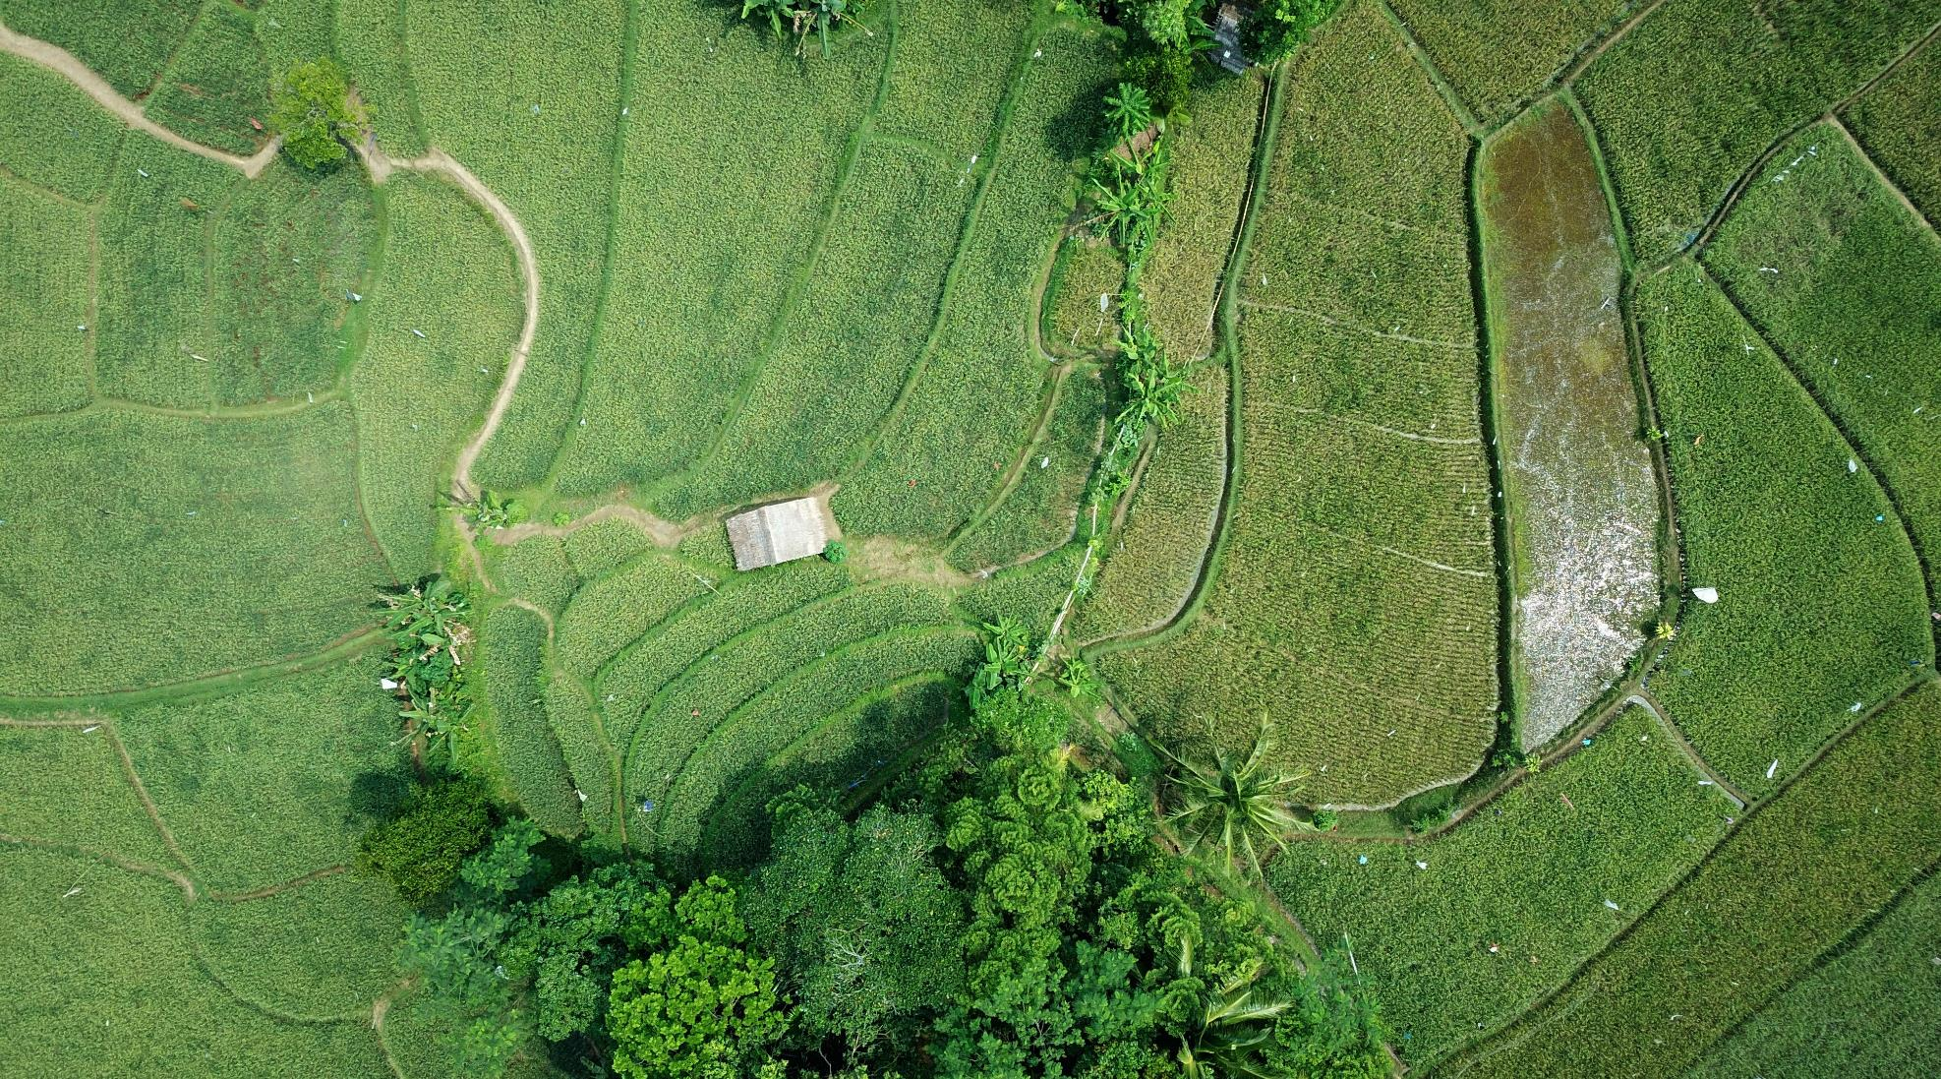
Eco Quest

Slide 2
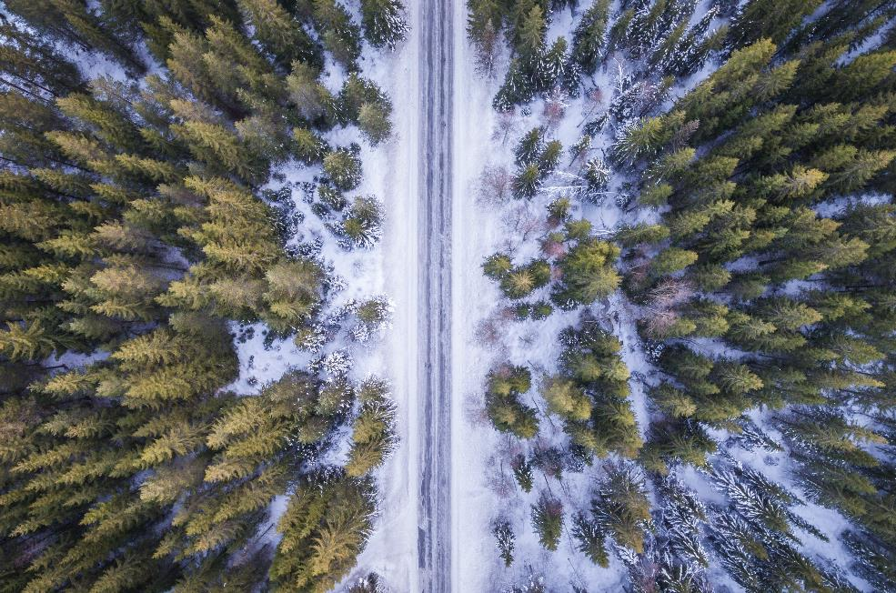
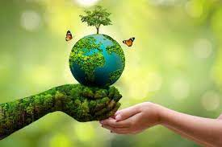
The theme of the project
The project is about improving our planet’s ecology

Slide 3
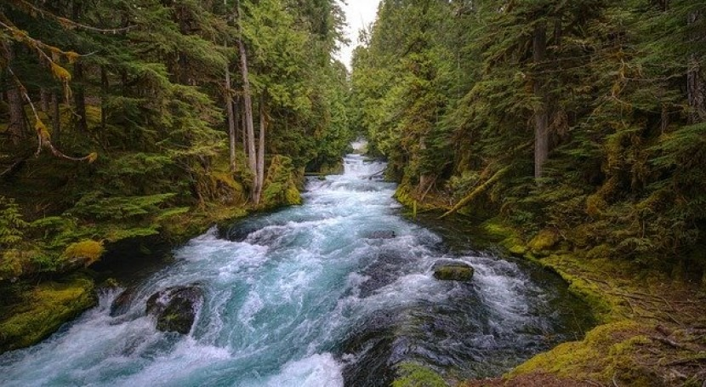

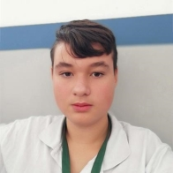


This is our team
Veselin Todorov 9V
Scrum Trainer (VBTodorov22)
Petko Ivanov 9V
Developer
(PSIvanov22)
Kristian Rusev 9V
Developer
(KARusev22)
Nikolay Yanakiev 9V
Designer
(NKYanakiev22)

Slide 4
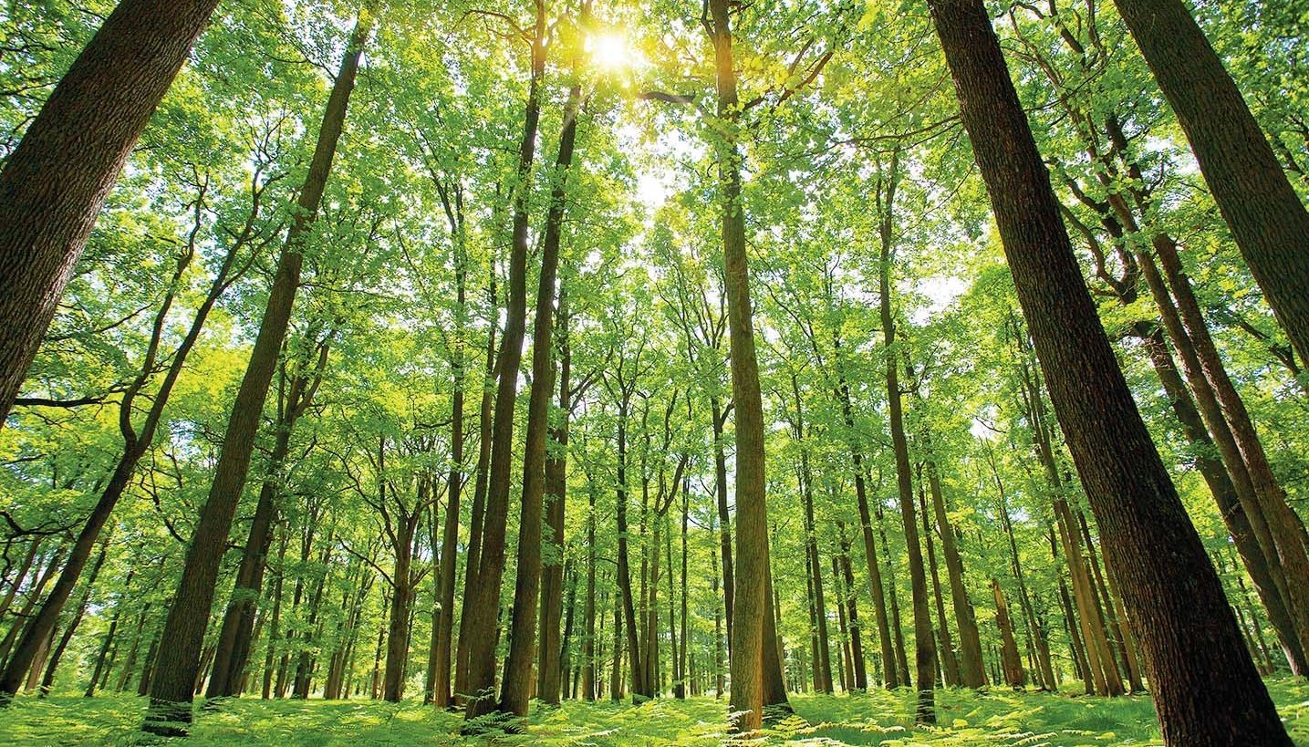
Stages of making our project
1. We made a plan about the project.
2. Nikolay had an idea for the design and he did it
3. Then we did the coding
4. We tested it and everything was looking good and it was working

Slide 5
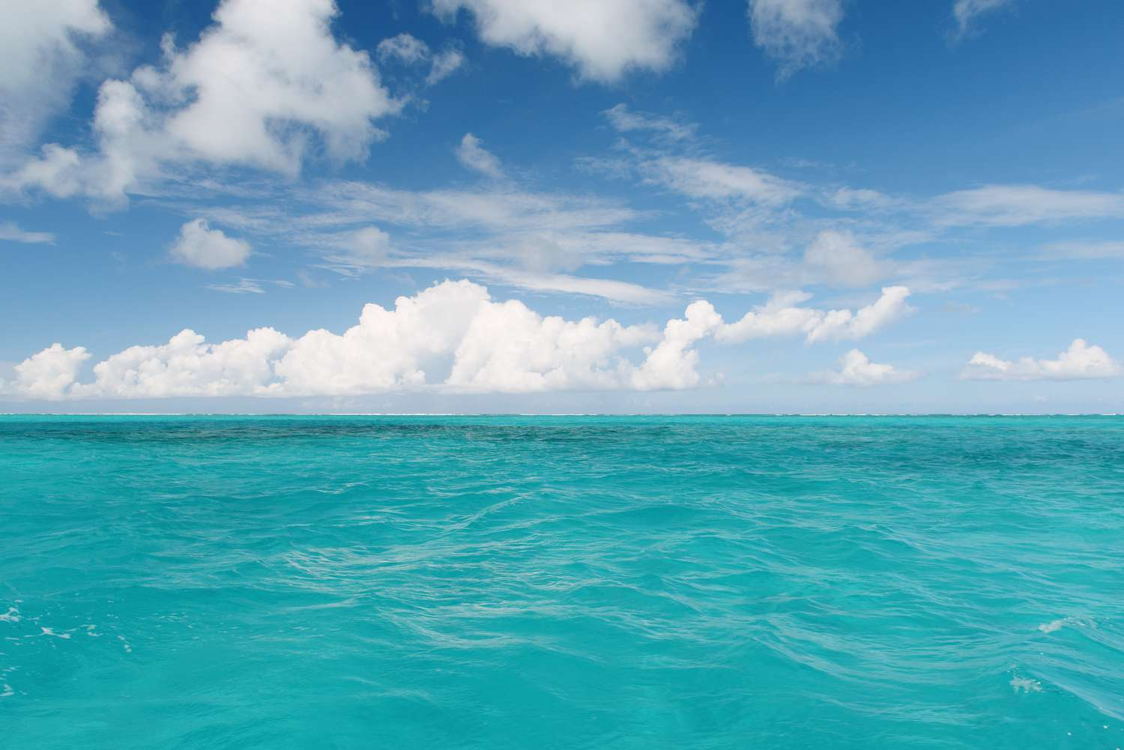


We used the languages

Slide 6
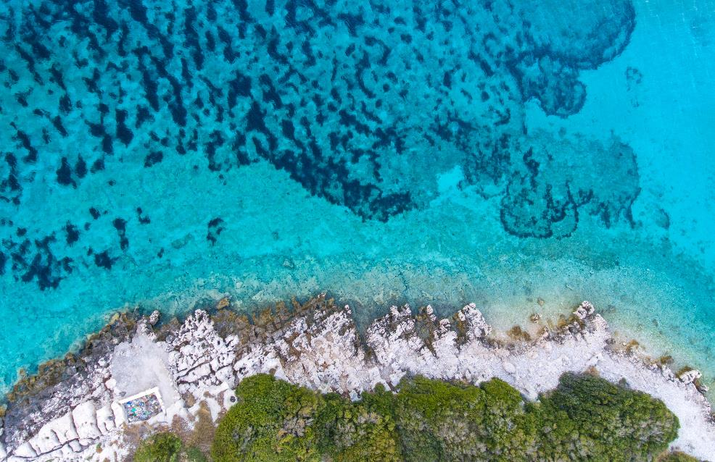



Apps we used

Slide 7
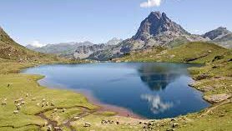
Let’s go to the site. Shall we?

